Slide 1
People’s Democratic Republic of Algeria
Ministry of Higher Education and Scientific Research
University of Batna -2- Moustafa Benboulaid
Faculty of nature and life sciences
Departement of the common core nature and life sciences
Presentation by: Nour El Yakine Ben Hachani
Under the supervision of the teacher: Chouha Nora

Slide 2
ASTROBIOLOGY

Slide 3
Introduction

Slide 4
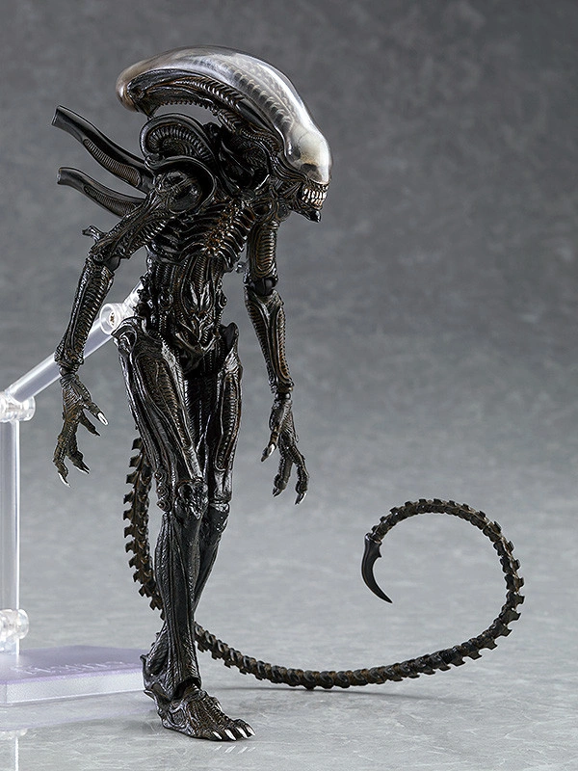
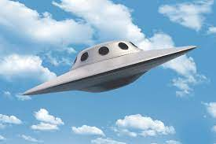
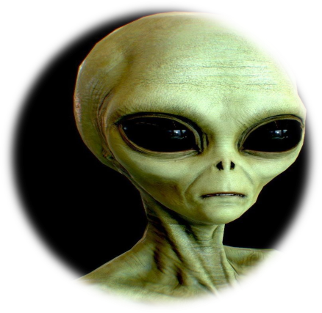
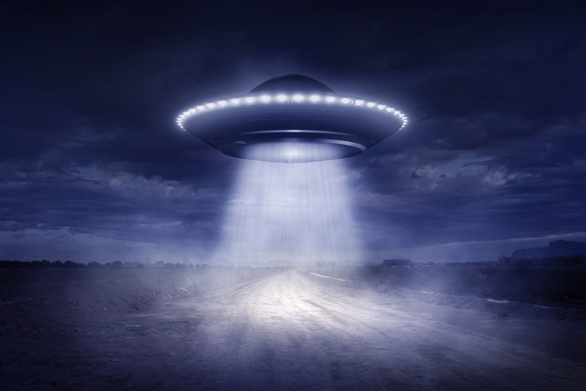

Slide 5
What is Astrobiology?
Definition
Astrobiology is the science that studies the origin distribution and evolution of life in the universe and it takes seven branches of sciences:

Slide 6
The 7 branches of sciences
04
Physics
06
Engineering
05
Chemistry
02
Geology
01
Biology
03
Astronomy
07
Sociology

Slide 7
‘Origins of life and environment’ explains that quite how life arose is unknown, but there is wide agreement that the origin of life would have been preceded by a period of chemical evolution, or prebiotic chemistry, during which more complex organic molecules were produced from simpler ones.
Origins of life and environment

Slide 8
From slime to the sublime:
‘From slime to the sublime’ asks: How did Earth maintain an environment fit for life? However life started, once establishe, it persisted for over 3.5 billion years and evolved from microbial slime to the sophistication of human civilization.

Slide 9
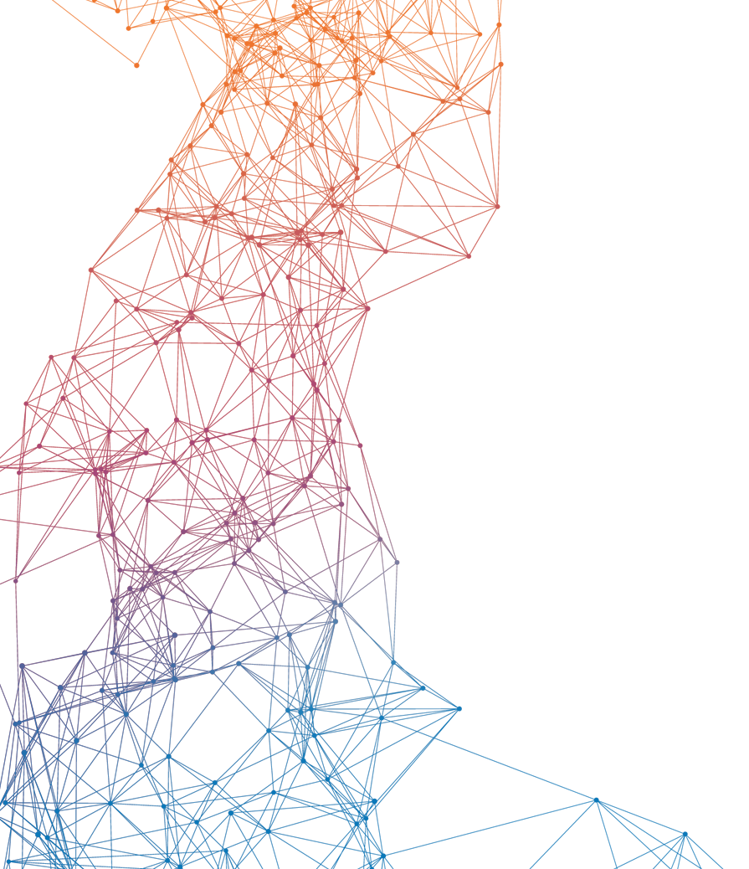
From stardust to planets, the abodes for life:
Life exists because following a Big Bang 13.8 billion years ago, a hot, dense cosmos expanded and cooled. As it did so, atoms, galaxies, stars, planets, and life arose.

Slide 10
Life in the Solar System :
On Earth, wherever we find liquid water, we find life, whether in bubbling hot springs, drops of brine inside ice, or films of water around minerals deep in the crust.
But perceptions have shifted. It's possible that there are subsurface ammonia-rich oceans on Saturn's moon Rhea and Uranus's largest moons Titania and Oberon. Given that so many objects in the Solar System are potential refuges for life, billions of similar possibilities surely exist throughout our galaxy.

Slide 11
The Research Projects
Life in Extreme Environments
types of organisms and their adaptations
how studying this environment and organisms helps us understand life on other planets.

Slide 12
Before I conclude
There is no Science without experiment
If we don’t experiment…
Then we have no right to call ourselves Scientists…

Slide 13
Thank you for listening

