Slide 1
SYRINGOMYELIE
DR M. H AMRANE
Service de neuro-chirurgie CHU BATNA

Slide 2
I. Introduction
entité anatomo-clinique: cavité rétro-ependymaire se développant sur plusieurs
segments médullaires et responsable d’un syndrome neuromusculaire
3 types de syringomyélie selon l’étiologie:
Syringomyélie foraminale: associée à des anomalies congénitales ou acquises de la charnière cranio-cervicale
Syringomyélie secondaire: post-traumatique, arachnoïdite, tumeur intra-rachidienne
Syringomyélie idiopathique.

Slide 3
II. Anatomie pathologique:
Lésion de la substance grise: Interruption des voies de la sensibilité extra-lemniscale ( sensibilité thermo-algésique)
Respect des cordons postérieurs: conservation de la sensibilité tactile et profonde consciente
L’extension de la cavité syringomyélique vers les cornes antérieures : destruction des neurones
La cavité syringomyélique touche plusieurs segments médullaires en respectant les segment au-dessus et au dessous : syndrome suspendu
Touche le plus fréquemment la moelle cervicale,
Contient du LCR riche en albumine,

Slide 4
III. Manifestations cliniques:
III.1. Symptomatologie révélatrice:
Douleurs neuropathiques (40%) .
Déficit moteur ou sensitif (20%).
Troubles de la déglutition, atteinte sensitive de la face, nystagmus.

Slide 5
III.2. Tableau constitué:
III.2.1. Le syndrome suspendu (syndrome lésionnel)
Dissociation syringomyélique: Anesthésie thermo-algique en territoire suspendu
Aréflexie
Parésie et amyotrophie
Troubles trophiques de la peau
Fractures spontanées, arthropathies du coude ou de l’épaule
Désordres vasomoteurs, œdème, hyperkératose

Slide 6
III.2.2. Le syndrome sous lesionnel
Para ou tetraparésie
Syndrome pyramidal
Syndrome cordonal postérieur
Troubles génitosphinctériens

Slide 7
IV. Examens complémentaires
IV.1. IRM médullaire:
MRI scanning is the most effective diagnostic tool for evaluating Syringomyelia. The standard comprehensive MRI study of this condition includes images obtained with and without Gadolinium (the paramagnetic "enhancing substance") that will help to diagnose the presence of a Spinal Cord Tumor.

Slide 8
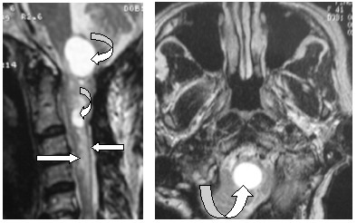
Figure 1A (Left): MRI Scan (Gadolinium Enhanced-Sagittal View). Syrinx in the Medulla & Superior Cervical Spinal Cord (Curved Arrows) in association with a Spinal Cord Tumor (Ependymoma-indicated by Horizontal Arrows) Figure 1B (Right): MRI Scan (Axial View-Same Patient). Large Syrinx in the Cervico-medullary junction (Arrow).

Slide 9
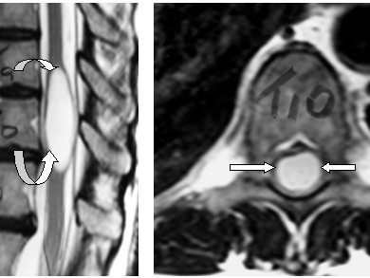
Figure 2A (Left): MRI Scan (Sagittal View). Thoracic (T9- T11) Syrinx in a 35 year old female (No Tumor). This widened "cyst' within the Thoracic Spinal Cord results in thinning the Spinal Cord in the periphery (Arrows) of the Syrinx. Figure 2B (Right): MRI Scan (Axial View-Same patient). The Thoracic Spinal Cord is a thin remnant (Arrows indicate the grey area inside the Spinal Canal) as it surrounds the Syrinx

Slide 10
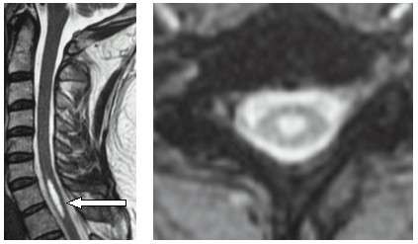
Figure 3A (Left): MRI Scan (Sagittal View). C7-T1 Level Syrinx (Arrow) in a 47 year old Male. 6 month history of tingling/numbness in his upper extremities and weakness in his hands. No tumor.
Figure 3B (Right): MRI Scan (Axial View-C7 Level-Same Patient). The Cervico-thoracic Syrinx occupies the center of the Spinal Cord resulting in "compression" of the normal Spinal Cord from within the substance of the Cord. Once symptoms develop, treatment becomes an important consideration

Slide 11
IV.2. Autres imageries
Les radiographies standards
Le scanner avec injection de PC
IV.3. Electrophysiologie
EMG
PES

Slide 12
V. Traitement
V.1. Non-surgical
Since the natural history of Syringomyelia in any individual patient is not immediately apparent, particularly if they are not symptomatic, surgical management may not be required or appropriate. These patients should be carefully monitored by a neurologist or neurosurgeon with experience in this disorder. Serial MRI scans together with periodic neurological evaluations are important since the failure to identify early neurological deterioration could result in irreversible deficits. Follow up may be required for many years. It is apparent that not all patients will advance to the stage where surgery is required; it is also true that evaluation of the condition is often difficult because Syringomyelia patients can remain stationary for long periods of time, while others progress rapidly.

Slide 13
V.2.Surgery
Surgery is the only available treatment for Syringomyelia since there are no medications, manipulations or interventions available for this disorder.
Posterior Fossa Craniotomy/Craniectomy

Slide 14
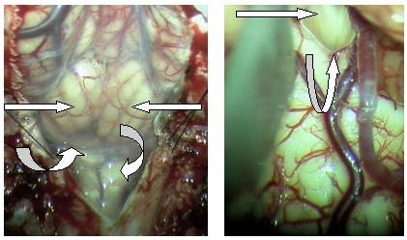
Figure 4A (Top Left): Operative Photo (Same Patient as Figures 3A&B) The Dura Mater has been opened after a Suboccipital Craniectomy & C1 Laminectomy. The Cerebellar Hemispheres (Horizontal Arrows) are seen through the intact Arachnoid. The Cervico-medullary Junction (Right Curved Arrow) is below. The horizontally oriented "band" of arachnoid indicates the level of the Foramen Magnum (Up-curved Arrow).

Slide 15
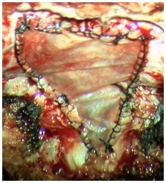
Figure 4B (Top Right): Operative Photo (Same Patient) The Cerebellar Hemispheres have been separated allowing access to the "floor" of the 4th Ventricle (Top Left Arrow). The posterior aspect of the Cervico-medullary junction and its blood supply is clearly seen and is normal. Figure 4C (Bottom Left): Operative Photo. A "Decompressive Dural Graft has been sutured in place resulting in a "decompression" and redirection of the flow of Cerebrospinal Fluid away from the Central Canal of the Spinal Cord which "originates" at the lower end of the 4th Ventricle (See Figure 4B at the "base of the V-shaped" structure which is near the top of the photo indicated by the Curved Arrow.)

Slide 16
Shunt Procedure
Terminal Ventriculostomy

